Slide 1
Code for AFT mediation analysis developed by C Ricci
Outline
Background and motivation
Survival analysis in biomedical research
Accelerated Failure Time Models
Mediation analysis
Statistical analysis
Data simulation
A Custom program for AFT mediation analysis
Considerations

Slide 2
Introduction and motivation -Survival analysis deals with events happening over the time-
Survival analysis is applied to a prospective collection of clinical events over the time
L.I.F.E. – Core Justifications for Survival Analysis in Biomedicine –
L – Longitudinal Event Tracking
Captures how outcomes evolve over time, not just whether they occur!
I – Interpretability of Time and Risk
Enables dual interpretation of outcomes
Time-to-event: When is an event likely to happen?
Risk : How does a patient’s feature determine the hazard of the outcome?
F – Flexibility with Complex Data
Adapts to complex, real-world biomedical scenarios, including:
Network models (Mediation analysis)
Health trajectories (Multistate analysis)
E – Evidence for Public Health Decision-Making
Supports clinical decisions

Slide 3
Modelling time to event -Survival analysis, a clinical viewpoint-
In clinical settings the survival analysis can answer the question: “When and how likely is it that a patient will experience a clinical event?”
We know that:
For some diseases, the risk is constant over time
The Cox model and exponential parametric models
Often, the longer a patient survives, the higher the risk becomes
Accelerated Failure Time (AFT) model
AFT models investigates how the diseases risk progress over time and so are more interpretable in patient-centered decisions (Clinical care)
AFT models are particularly useful for estimating absolute survival times, such as median or expected time to event, which can aid clinicians in prognosis communication and treatment planning
AFT models can accommodate various survival distributions, offering flexibility to better capture the underlying disease processes compared to traditional proportional hazards models

Slide 4

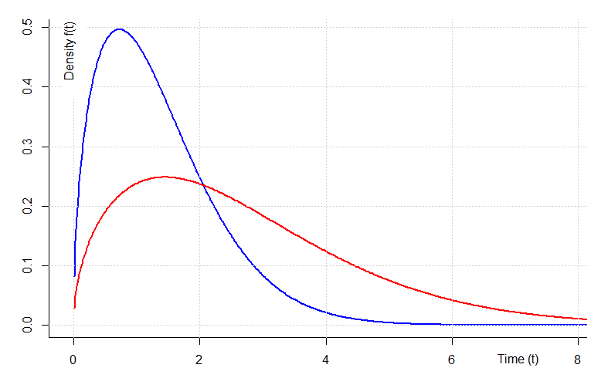
Modelling time to event -Time to event distributions-
In AFT modelling the outcome is the time to event T that in turn is linked to a set of covariates
In this seminar we will focus on the Weibull distribution for convenience
The PDF f(t) helps visualize when events are most likely to happen over the time
Scale parameter
stretches or compresses the time axis
λ > λ
λ = exp(Xβ)

Slide 5
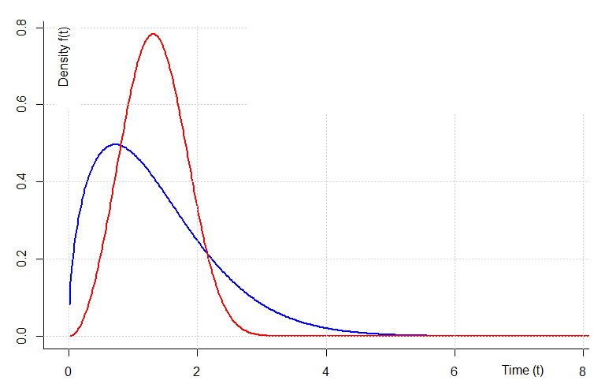
Modelling time to event -Time to event distributions-
In AFT modelling the outcome is the time to event T that in turn is linked to a set of covariates
In this seminar we will focus on the Weibull distribution for convenience
The PDF f(t) helps visualize when events are most likely to happen over the time
Shape parameter
controls how the hazard rate (Instantaneous risk) behaves over time
γ > γ

Slide 6

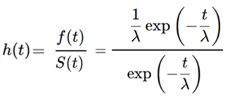


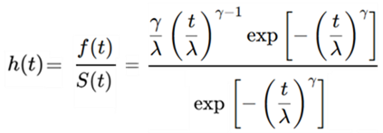



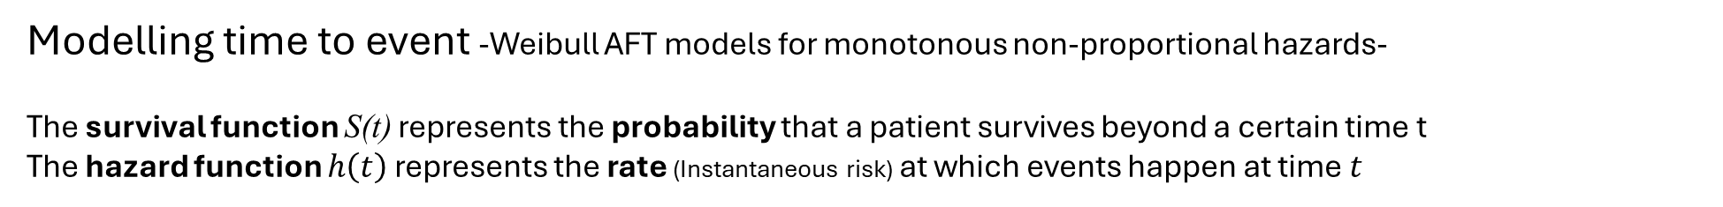
Modelling time to event -Weibull AFT models for monotonous non-proportional hazards-
The survival function S(t) represents the probability that a patient survives beyond a certain time t
The hazard function $h\left(t\right)$ represents the rate (Instantaneous risk) at which events happen at time $t$
The probability density function describes the shape of the distribution of time to event
h(t) can assume different forms:
The hazard is constant
The hazard changes with γ
The Weibull distribution was chosen because it represents a special case of non-proportional hazards
→ Change γ to have proportional or non-proportional h(t)

Slide 7
Mediation analysis in the survival analysis framework -Estimation of time to event-
A mediator (M) is a factor that lies and mediate the relation between an exposure (X) and on outcome (Y)
c
X
Y
a
b
M

Slide 8
Mediation analysis in the survival analysis framework -Estimation of time to event-
A mediator (M) is a factor that lies and mediate the relation between an exposure (X) and on outcome (Y)
c
Let’s imagine the relation between hypertension (HYP) and cardiovascular disease risk (CVD) with endothelial dysfunction acting as mediator
HYP
CVD
a
b
ED

Slide 9
Mediation analysis in the survival analysis framework -Estimation of time to event-
A mediator (M) is a factor that lies and mediate the relation between an exposure (X) and on outcome (Y)
c
HYP
CVD
c ← Direct effect
a*b ← Indirect effect
c + a*b ← Total effect
How hypertension influence cardiovascular function directly
a
b
ED

Slide 10
Mediation analysis in the survival analysis framework -Estimation of time to event-
A mediator (M) is a factor that lies and mediate the relation between an exposure (X) and on outcome (Y)
c
HYP
CVD
c ← Direct effect
a*b ← Indirect effect c + a*b ← Total effect
How hypertension influence cardiovascular function through endothelial dysfunction
a
b
ED

Slide 11
Mediation analysis in the survival analysis framework -Estimation of time to event-
A mediator (M) is a factor that lies and mediate the relation between an exposure (X) and on outcome (Y)
c
HYP
CVD
c ← Direct effect
a*b ← Indirect effect c + a*b ← Total effect
How hypertension influence cardiovascular function in total
a
b
ED

Slide 12
Mediation analysis in the survival analysis framework -Estimation of time to event-
A mediator (M) is a factor that lies and mediate the relation between an exposure (X) and on outcome (Y)
c
HYP
CVD
c ← Direct effect
a*b ← Indirect effect c + a*b ← Total effect
a
b
ED
This approach answers questions like: “How much of the effect of hypertension on cardiovascular disease is mediated through endothelial dysfunction?”
Counterfactual causation approach (Stijn Vansteelandt and Tyler J Vanderweele)
NDE: The Natural Direct Effect is the effect of hypertension on the time to CVD, holding endothelial dysfunction constant at the level it would take if the person were not hypertensive
…If we could somehow prevent hypertension from damaging endothelial function, but a person still had hypertension, how much would hypertension on its own (through other mechanisms) speed up the onset of cardiovascular disease?

Slide 13
Mediation analysis in the survival analysis framework -Estimation of time to event-
A mediator (M) is a factor that lies and mediate the relation between an exposure (X) and on outcome (Y)
c
HYP
CVD
c ← Direct effect
a*b ← Indirect effect c + a*b ← Total effect
a
b
ED
This approach answers questions like: “How much of the effect of hypertension on cardiovascular disease is mediated through endothelial dysfunction?”
Counterfactual causation approach (Stijn Vansteelandt and Tyler J Vanderweele)
NIE: The Natural Indirect Effect is the portion of hypertension’s effect on time to CVD that is due to its effect on endothelial dysfunction, which then influences CVD timing
…the NIE tells us how much earlier CVD occurs due to endothelial dysfunction caused by hypertension (assuming the person’s hypertension status stays the same)
…we are almost ready to analyse some data, but first we need the data!

Slide 14







Mediation analysis in the AFT framework -Data simulation (The logic of)-
Time to event follows a Weibull distribution with explicit scale parameter (A), shape parameter (γ) and covariates (Xβ)
From the “Inverse Transform Sampling”
Explicit scale parameter for scaling time to events on a meaningful metric of time
Logarithm
Re-arrange
Solve for t
The Weibull distribution was chosen because simple to simulate in models
1-U = U

Slide 15



Mediation analysis in the AFT framework -Data simulation (The logic of)-
Time to event follows a Weibull distribution with explicit scale parameter (A), shape parameter (γ) and covariates (Xβ)
The time to censor is simulated following a Weibull distribution of other parameters
In this “real word mimic” simulation T and C compete, exactly as it happens in the real life…
Healthy
CVD
If the event happen before the censor the data appear as observed
Healthy
CVD
If the event happen after the censor the data appear as censored (lost)
Censor
…the parameters of T and C will be chosen to determine specific censoring rates in the simulation

Slide 16
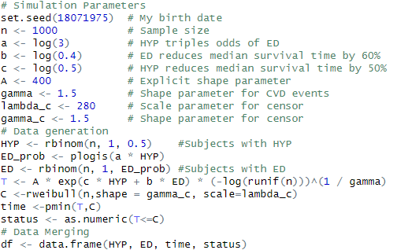
Mediation analysis in the AFT framework -Data simulation (The code)-
Simulation parameters

Slide 17

Mediation analysis in the AFT framework -Data simulation (The code)-

Slide 18
Mediation analysis in the AFT framework -Data simulation (The code)-
T ~ W(γ, λ)

Slide 19
Mediation analysis in the AFT framework -Data simulation (The code)-
Data Generation

Slide 20
Mediation analysis in the AFT framework -Data simulation (The code)-
Hypertension: Random 50% of participants has hypertension

Slide 21
Mediation analysis in the AFT framework -Data simulation (The code)-
The hypertension increases the risk of endothelial dysfunction by a factor of 3

Slide 22
Mediation analysis in the AFT framework -Data simulation (The code)-
The time to event and censoring are simulated using a Weibull distribution

Slide 23
Mediation analysis in the AFT framework -Data simulation (The code)-
The observed time (for event or censored) is the minimum between T and C
We observe an event if T ≤ C

Slide 24
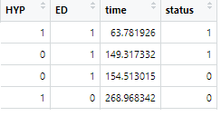
Mediation analysis in the AFT framework -Data simulation (The code)-
Data are merged into a data frame

Slide 25
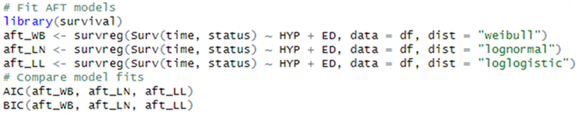
Mediation analysis in the AFT framework -Data simulation (Checking distribution)-
Check for Weibull fitting using information criteria to AFT regression

Slide 26


Mediation analysis in the AFT framework -Data simulation (Checking distribution)-
The lower the better

Slide 27
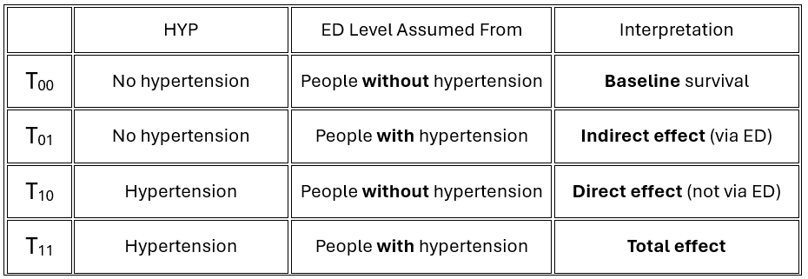
Mediation analysis in the AFT framework -Data analysis: Counterfactual mediation analysis-
A custom program for mediation analysis with AFT models was developed and compared to mediation package...
https://github.com/cristianricciwork-commits/aft-mediation./blob/main/Mediation%20analysis.R
The strategy was to estimate survival times under the counterfactual scenarios; the counterfactual effects will be given by survival time differences between certain categories
The counterfactual scenarios are:
Reference scenario: expected survival without HYP or ED

Slide 28
Mediation analysis in the AFT framework -Data analysis: Counterfactual mediation analysis-
A custom program for mediation analysis with AFT models was developed and compared to mediate package...
https://github.com/cristianricciwork-commits/aft-mediation./blob/main/Mediation%20analysis.R
The strategy was to estimate median survival times under the counterfactual scenarios; the counterfactual effects will be given by survival time differences between certain categories
The counterfactual scenarios are:
Isolated impact of ED, independent of hypertension

Slide 29
Mediation analysis in the AFT framework -Data analysis: Counterfactual mediation analysis-
A custom program for mediation analysis with AFT models was developed and compared to mediate package...
https://github.com/cristianricciwork-commits/aft-mediation./blob/main/Mediation%20analysis.R
The strategy was to estimate median survival times under the counterfactual scenarios; the counterfactual effects will be given by survival time differences between certain categories
The four counterfactual scenarios are:
Direct impact of hypertension, not mediated by ED

Slide 30
Mediation analysis in the AFT framework -Data analysis: Counterfactual mediation analysis-
A custom program for mediation analysis with AFT models was developed and compared to mediate package...
https://github.com/cristianricciwork-commits/aft-mediation./blob/main/Mediation%20analysis.R
The strategy was to estimate median survival times under the counterfactual scenarios; the counterfactual effects will be given by survival time differences between certain categories
The counterfactual effects are performed as:
NIE = T₀₁ - T₀₀ ← The indirect effect: how much survival changes because hypertension alters ED
NDE = T₁₀ – T₀₀ ← The direct effect: how much survival changes because of hypertension itself, not through ED
TE = NIE + NDE ← The total effect: the overall impact of hypertension, both directly and indirectly via ED

Slide 31
Mediation analysis in the AFT framework -Data analysis: The algorithm-
The analysis follows a 3-step modular structure, which not only improves interpretability but also allows flexible adaptation to complex designs
Program code
https://github.com/cristianricciwork-commits/aft-mediation./blob/main/Mediation%20analysis.R
Set random seed
Define number of bootstraps
Load required packages
Settings
Fit AFT model (Weibull)
Perform counterfactual effects
Simulate counterfactual effects
Core
Let’s focus on the “Core”
Repeat core calculation 5,000×
Resample with replacement
Derive 95% confidence intervals
Bootstrap

Slide 32
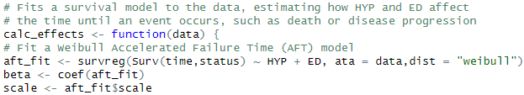
Mediation analysis in the AFT framework -Data analysis: The algorithm-
The analysis follows a 3-step modular structure, which not only improves interpretability but also allows flexible adaptation to complex designs
Program algorithm
https://github.com/cristianricciwork-commits/aft-mediation./blob/main/Mediation%20analysis.R
Set random seed
Define number of bootstraps
Load required packages
Settings
Fit AFT model (Weibull)
Perform counterfactual effects
Simulate counterfactual effects
Core
Repeat core calculation 5,000×
Resample with replacement
Derive 95% confidence intervals
Bootstrap

Slide 33
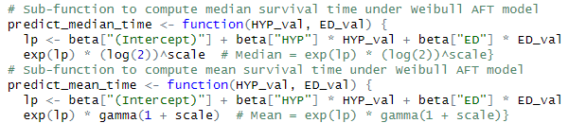
Mediation analysis in the AFT framework -Data analysis: The algorithm-
The analysis follows a 3-step modular structure, which not only improves interpretability but also allows flexible adaptation to complex designs
Program algorithm
https://github.com/cristianricciwork-commits/aft-mediation./blob/main/Mediation%20analysis.R
Set random seed
Define number of bootstraps
Load required packages
Settings
Fit AFT model (Weibull)
Perform counterfactual effects
Simulate counterfactual effects
Core
Repeat core calculation 5,000×
Resample with replacement
Derive 95% confidence intervals
Bootstrap

Slide 34

Mediation analysis in the AFT framework -Data analysis: The algorithm-
The analysis follows a 3-step modular structure, which not only improves interpretability but also allows flexible adaptation to complex designs
Program algorithm
https://github.com/cristianricciwork-commits/aft-mediation./blob/main/Mediation%20analysis.R
Set random seed
Define number of bootstraps
Load required packages
Settings
Fit AFT model (Weibull)
Perform counterfactual effects
Simulate counterfactual effects
Core
Repeat core calculation 5,000×
Resample with replacement
Derive 95% confidence intervals
Bootstrap

Slide 35
Mediation analysis in the AFT framework -Results: comparison with the mediate package-
The mediation package was compared to our custom program
The mediation package is often considered a "gold standard" for counterfactual mediation analysis in R, but like any method, it has its assumptions, strengths, and limitations (Especially when dealing with survival data and AFT models)
Mediation Analysis for Censored Survival Data under an Accelerated Failure Time Model
Isabel R. Fulcher, Eric Tchetgen Tchetgen, Paige L. Williams
“We formally show that these two methods [‘difference’ and ‘product’] may produce substantially different estimates in the presence of censoring or truncation, due to a form of model misspecification”
Causal mediation analysis with survival data
Tyler J VanderWeele
Mediation analysis in the context of survival outcomes, particularly under accelerated failure time (AFT) models, presents unique methodological challenges that are not fully addressed by standard approaches.
These include issues related to censoring, model specification, and scale of effect estimation, underscoring the need for tailored strategies when interpreting indirect and direct effects in time-to-event data.

Slide 36
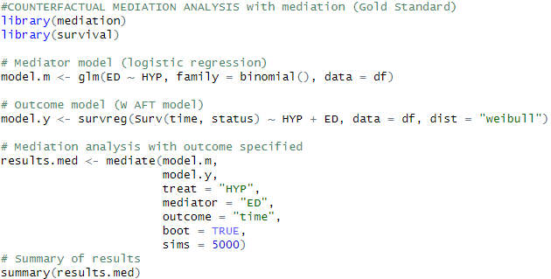
Mediation analysis in the AFT framework -Results: comparison with the mediation package-
Logistic regression for ED ~ HYP
AFT for CVD ~ ED + HYP
The mediate function is used to compute NDE and NIE

Slide 37
Mediation analysis in the AFT framework -Results: comparison with the mediation package-
Scenario I
Fixed part
Sample size = 1000
a = log(3) # HYP triples odds of ED
b = log(0.4) # ED reduces median survival time by 60%
c = log(0.5) # HYP reduces median survival time by 50%
Variable part
Censoring ~ 50%
Shape parameter (Non proportionality of hazard) = 2.5
Estimates and 95% bootstrap CIs
Under mild scenario there is a substantial overlapping of the effect performed by the two different procedures…
…when the custom procedures adopt median of time to even for the counterfactual scenarios

Slide 38
Mediation analysis in the AFT framework -Results: comparison with the mediation package-
Scenario I
Fixed part
Sample size = 1000
a = log(3) # HYP triples odds of ED
b = log(0.4) # ED reduces median survival time by 60%
c = log(0.5) # HYP reduces median survival time by 50%
Variable part
Censoring ~ 50%
Shape parameter (Non proportionality of hazard) = 2.5
Estimates and 95% bootstrap CIs
Even better overlapping of the effect performed by the two different procedures…
…when the custom procedures adopt average of time to even for the counterfactual scenarios

Slide 39
Mediation analysis in the AFT framework -Results: comparison with the mediation package-
Scenario II -Proportionality of hazards-
Fixed part
Sample size = 1000
a = log(3) # HYP triples odds of ED
b = log(0.4) # ED reduces median survival time by 60%
c = log(0.5) # HYP reduces median survival time by 50%
Variable part
Censoring ~ 50%
Shape parameter (Proportionality of hazard) = 1
Estimates and 95% bootstrap CIs
We observed larger confidence limits and slightly effect sizes in the custom program with likelihood of overlapping of CIs of NIE and NDE

Slide 40
Mediation analysis in the AFT framework -Results: comparison with the mediation package-
Scenario II -Proportionality of hazards-
Fixed part
Sample size = 1000
a = log(3) # HYP triples odds of ED
b = log(0.4) # ED reduces median survival time by 60%
c = log(0.5) # HYP reduces median survival time by 50%
Variable part
Censoring ~ 50%
Shape parameter (Strong non proportionality of hazard) = 5
Estimates and 95% bootstrap CIs
We observed comparable confidence limits and effect sizes a stronger non proportionality of hazards seems to correspond to smaller confidence limits

Slide 41
Mediation analysis in the AFT framework -Results: comparison with the mediation package-
Scenario III -Censoring effects-
Fixed part
Sample size = 1000
a = log(3) # HYP triples odds of ED
b = log(0.4) # ED reduces median survival time by 60%
c = log(0.5) # HYP reduces median survival time by 50%
Variable part
Censoring ~ 90%
Shape parameter (Non proportionality of hazard) = 2.5
Large censoring rate
Estimates and 95% bootstrap CIs
Extreme quantity of censoring results in extremely large confidence limits

Slide 42
Mediation analysis in the AFT framework -Results: comparison with the mediation package-
Scenario III -Censoring effects-
Fixed part
Sample size = 10000
a = log(3) # HYP triples odds of ED
b = log(0.4) # ED reduces median survival time by 60%
c = log(0.5) # HYP reduces median survival time by 50%
Sample size increase by 10X
Variable part
Censoring ~ 90%
Shape parameter (Non proportionality of hazard) = 2.5
Estimates and 95% bootstrap CIs
Larger sample size compensate the high proportion of censoring

Slide 43
Mediation analysis in the AFT framework -Considerations-
AFT (Flexibility) and mediation analysis (Meaningful interpretation) can be merged to enhance scientific evidence
Proper tools are available but custom implementation is also possible
→ Our custom program seems to give comparable estimates compared to mediation
Should we use a custom approach when accredited tools are present?
No, but what if accredited tools can be questioned?
Is it worthy to develop a customed tool for AFT in mediation analysis?
Maybe, but we cannot understand if it works better than mediation
→ It is difficult to simulate counterfactual effects
What if we demonstrate that our custom tool is equivalent to mediation?
A custom tool can be implemented easier than an already existing package
→ Our program produces baseline time to events and % of expected time effects
Should I use a custom program in real life?
No, unless it is necessary to adapt to specific problems that ordinary tools can’t manage
→ Use of advanced analysis with survey data

Slide 44
Thank you for the attention!
Questions?

